Slide 1
AI Token
Calculation
MSDEVBUILD
LIVE SESSION · SESSION 1
Tokens in, credits out
1
Text is split into tokens
From “what is a token?” to cost and optimisation, in 9 steps
2
Input and output are counted
FORMAT
SPEAKER
Talk + worked examples
  Tokens · Context · Cost
Suthahar Jegatheesan
  Cloud, AI & Mobile Solutions Architect
3
Priced per model, in credits

Slide 2
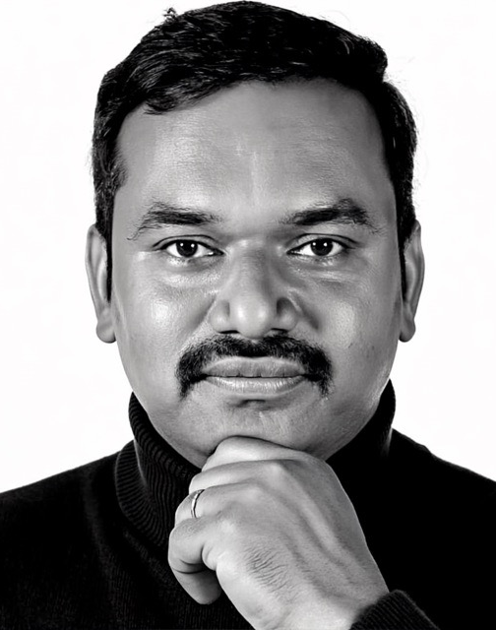

Suthahar
Jegatheesan
ABOUT THE SPEAKER
SINCE 2007
CLOUD, AI & MOBILE SOLUTIONS ARCHITECT
Helping the IT industry since 2007, with a passion for giving developers a helping hand across India and Malaysia.
19+
5M+
15K+
50+
years in IT
content views
developers
talks
RECOGNITION
Azure Content Hero
C# Corner MVP
SCAN ME
LinkedIn
Connect with me
India · Malaysia
Speaks English and Tamil
Top 100 Azure Blogs
MCT

Slide 3
Agenda: nine steps, beginner to expert
MSDEVBUILD · AGENDA
01
BEGINNER
02
BEGINNER
03
BEGINNER
Start here
Learn tokens
Watch it generate
04
PRACTITIONER
05
PRACTITIONER
06
EXPERT
The best way to ask
Continue or start fresh?
Calculation patterns
07
EXPERT
08
EXPERT
09
EXPERT
Instructions, skills & hooks
How to write them
Habits & final check

Slide 4
Electricity bill, water bill… now the token bill
BEFORE WE START · A NEW MONTHLY BILL
Same rule for all three: the meter runs while you use it.
THEN
Electricity bill
Paid per kWh
Classic leak: Lights left on all night.
THEN
Water bill
Paid per litre
Classic leak: Tap left running while you brush.
NOW
Token bill
Paid per token, in and out
Classic leak: A chat left open all week, plus “thanks!”
Good news: the token bill is the easiest of the three to cut. That is what today is about.

Slide 5
Your “thank you” to Copilot is paid in tokens
BEFORE WE START · WHY THIS SESSION
Every message is a new request, even a polite one. It is billed as input and output.
A FAMILIAR CHAT
RECEIPT FOR ONE THANK-YOU
Copilot, fix my cart bug!
Input · chat history re-sent
12,000 tokens
Input · “Thank you so much…”
7 tokens
Fixed. Tax now rounds once. Here’s the diff.
Output · “You’re welcome…”
10 tokens
≈ 2.4 credits
$0.024 each. 100 thank-yous ≈ 240 credits.
Thank you so much, Copilot!
You’re welcome! Happy coding.
Your thanks goes to the token meter.
Today: see where every token goes, then spend them on purpose.
The thank-you is a brand-new request, and the whole chat rides along with it.

Slide 6
Start here
STEP 01 OF 09 · BEGINNER
01
WHAT YOU WILL SEE
1
Text becomes tokens
2
Why pay per token
3
Tokens × price = credits
What a token is, and the one line that turns tokens into a bill.

Slide 7
A token is a bite-size piece of text
STEP 01 · START HERE
A tokenizer chops your text into pieces before the model reads it. Every piece is one token, and every token is billed.
THE SAME IDEA, THREE WAYS
WATCH THE TOKENIZER CUT · CLICK TO PLAY
FOR A FIVE-YEAR-OLD
AI eats words in snack-size bites. One bite is one token.
“Copilot, fix my cart bug!”
FOR A DEVELOPER
Like a lexer: text becomes IDs from a fixed vocabulary of 100K–200K pieces.
Cop
ilot
,
·fix
·my
·cart
·bug
!
13379
24426
11
5155
856
7353
10077
0
8 tokens from 25 characters and 5 words
FOR YOUR WALLET
Each token is one tick on the meter. Input and output tick at different rates.

Slide 8
Token talk: five fun terms for today
STEP 01 · START HERE
Nicknames for the words behind every AI bill. Shout them back when they come up later.
TOKENIZER
Pizza cutter
Slices your text into pieces before the model reads it.
VOCABULARY
LEGO box
Every piece the model knows, each with its own ID number.
CONTEXT WINDOW
Lunch box
Only so much fits in one request. Overfill it and old bites fall out.
TOKEN SNOWBALL
Snowball
Each message re-sends the whole chat, so long chats keep growing.
TOKEN DIET
Snack diet
Send less, ask clearly, and get the same answer for fewer tokens.
Listen for them later: the lunch box and the snowball in Step 02, the snack diet in Step 09.

Slide 9
Per token: a meter, not a buffet
STEP 01 · START HERE
A flat price works when everyone eats about the same. With AI, one request can cost 1,000× another.
FLAT SUBSCRIPTION · THE BUFFET
One price for all. Heavy eaters cost the most, so limits appear.
PER TOKEN · THE ELECTRICITY METER
You pay for what you use. A quick question costs a fraction of a cent.
WHY TOKENS, NOT A FLAT FEE
1
Cost follows compute
Every token in and out is GPU work the provider pays for.
2
Fair for everyone
Light users don’t fund someone else’s 40-file review.
THE TOKEN METER · INPUT AT $2 PER 1M TOKENS
Quick question “What does this regex do?”
150 tokens · $0.0003
3
You pick the price
Smaller models charge less per token than premium ones.
Agent reviews a repo 40 files in one task
200,000 tokens · $0.40
Most plans mix both: an allowance, then the meter runs.
1,333× more tokens. A buffet would charge both the same.

Slide 10
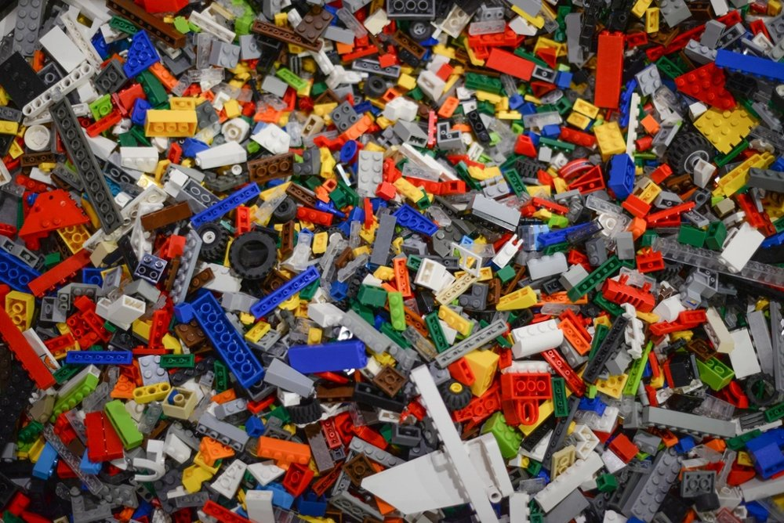
Tokens are LEGO bricks
STEP 01 · START HERE
Models don’t read letters or words. They read small pieces of text called tokens, and each piece has an ID.
GUESS THE TOKEN COUNT
ONE WORD, MANY BRICKS
“Add a discount code to the checkout screen”
Supercalifragilistic
42
characters
8
words
?
tokens
Super
cal
if
rag
il
istic
8
tokens
1 word = 6 tokens
unbelievable
Add
·a
·discount
·code
·to
·the
·checkout
·screen
un
bel
ievable
2578
261
11522
3490
316
290
30011
6188
1 word = 3 tokens
Mary Poppins would get a bigger bill.
Common words are one brick, often with the space in front (shown as ·).

Slide 11
The one-line bill
STEP 01 · START HERE
Every kind of token has its own price per million, set by the model you pick.
WHAT YOU SEND
Input
full input price
WHAT’S REUSED
Cached
~10% of input
WHAT’S STORED
Cache writes
~1.25× input
WHAT COMES BACK
Output
~5× input
THE BILL
AI Credits
1 credit = $0.01
+
+
+
=
WORKED EXAMPLE · ONE CHAT REQUEST · CLAUDE SONNET 5.5
6%
of the tokens were output…
…but output was 25% of the bill. The taxi meter has a premium fare.
12,000 input tokens × $2 per 1M = $0.024 = 2.4 credits
800 output tokens × $10 per 1M = $0.008 = 0.8 credits
3.2 credits ≈ 3 US cents

Slide 12
Learn tokens
STEP 02 OF 09 · BEGINNER
02
WHAT YOU WILL SEE
1
The 4-character rule
2
Input vs output
3
Cache and context window
Six everyday pictures: bricks, a parcel, a taxi meter, a packed box, a snowball, a courier.

Slide 13
The 4-character rule
STEP 02 · LEARN TOKENS
For English, 1 token ≈ 4 characters ≈ ¾ of a word. Code and data need more bricks.
RULE OF THUMB
TOKENS PER 100 CHARACTERS · MEASURED
1 token
≈ 4 characters ≈ ¾ word
English sentence
42 chars → 8 tokens
19
Dart code (cart_bloc.dart)
741 chars → 173 tokens
100 tokens
≈ 75 words
23
Test log
539 chars → 162 tokens
30
1,000 tokens
≈ 1½ pages of text
JSON order
357 chars → 133 tokens
37
Brackets, quotes, dots and indents are bricks too. JSON costs ~2× English.

Slide 14
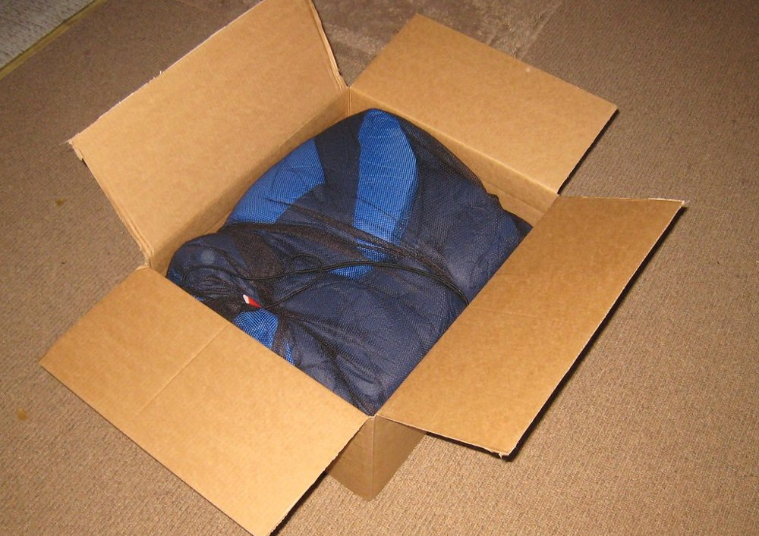
Input: your request is a parcel
STEP 02 · LEARN TOKENS
You write a short note. Copilot packs a whole parcel around it, and you pay for the whole parcel.
12,000
input tokens in total
WHAT ONE REQUEST CARRIES · INPUT TOKENS
Your note
10
Copilot’s rulebook (system prompt)
2,100
Project instructions
650
Toolbox (tool definitions)
1,900
0.08%
is the note you typed.
Tip: point at the files that matter, not the whole repo.
Earlier messages
3,200
Code files you pointed at
4,140

Slide 15
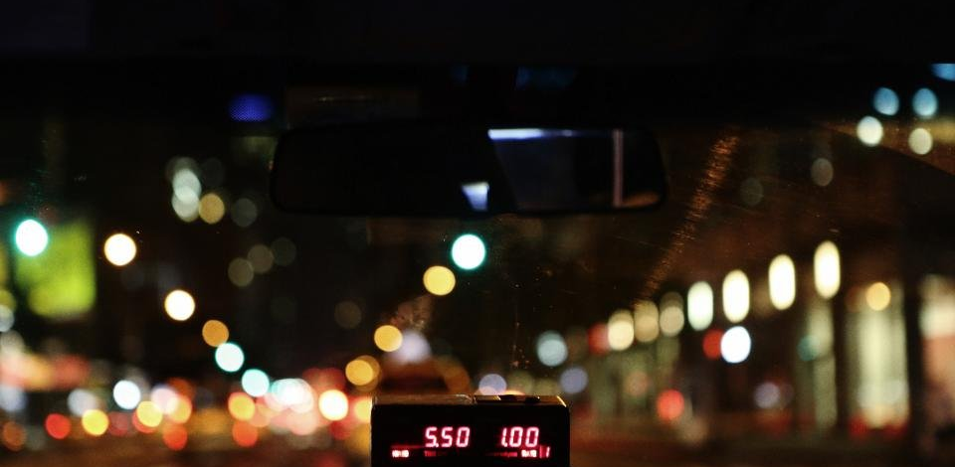
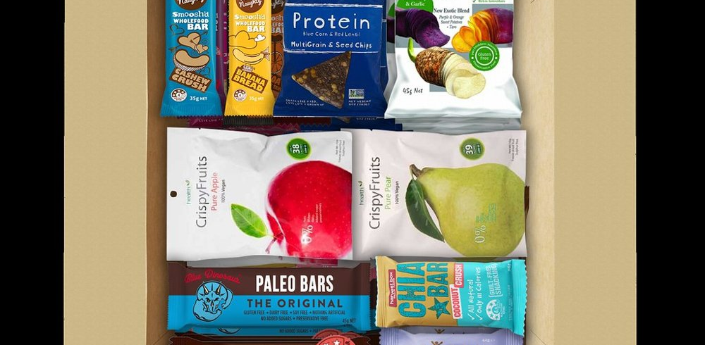

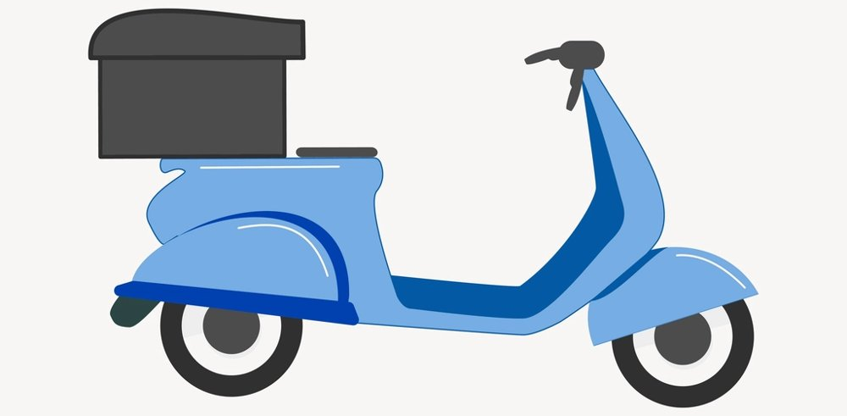
Four more pictures, four worked numbers
STEP 02 · LEARN TOKENS
Every number uses Claude Sonnet 5.5: $2 input, $0.10 cached, $10 output per 1M tokens.
OUTPUT · TAXI METER
CACHE · PACKED BOX
HISTORY · SNOWBALL
MODEL · COURIER
The meter ticks per token
Reuse what’s already packed
It re-sends the chat
Economy or express
The answer is written one token at a time at the premium fare.
A follow-up a minute later reuses most of the parcel at a tenth of the price.
The model has no memory, so message 5 carries messages 1 to 4.
The same parcel costs very different amounts by courier.
300-token diff = 0.3 cr
3,000-token file = 3.0 cr
Fresh 12,000 = 2.40 cr
11,000 cached + 1,000 = 0.31 cr
You typed 5K tokens
Copilot sent 105K
12K in + 800 out:
Haiku 5.5 0.16 cr · Astra 16 cr

Slide 16
The context window: the box has a size
STEP 02 · LEARN TOKENS
Each request must fit the model’s context window. A long chat fills it, and big requests can cost more per token.
THE SNOWBALL · 12K START, 1K QUESTION + 3K ANSWER EACH
THE LONG-CONTEXT PRICE LINE
context window limit (illustrative)
Some models charge more per token once one request passes a size line. GPT-5.6 Sol doubles above 272K input tokens.
29K
25K
21K
17K
300K input at $4 per 1M = 120 cr
13K
300K input at $8 per 1M = 240 cr
Stay under the line
/context in Copilot CLI shows how full the window is.
MSG 1
MSG 2
MSG 3
MSG 4
MSG 5

Slide 17
Watch it generate
STEP 03 OF 09 · BEGINNER
03
WHAT YOU WILL SEE
1
Predict the next token
2
Stop at the end token
3
Hidden thinking tokens
A model writes one token at a time, and every one of them is billed.

Slide 18
One token at a time
STEP 03 · WATCH IT GENERATE
The model predicts the most likely next token, adds it, and repeats until it predicts an end token.
YOUR PROMPT (INPUT) THEN THE ANSWER (OUTPUT)
NEXT-TOKEN GUESSES · STEP 1
The
·checkout
·button
·should
stay
46%
·stay
·disabled
·until
·the
·cart
·loads
.
end
be
27%
show
15%
only
8%
4
input tokens · read in one pass
8
output tokens · 8 passes
Illustrative odds. Each output token needs its own pass, which is why output costs 3–8× input.

Slide 19
Thinking tokens: a hidden meter
STEP 03 · WATCH IT GENERATE
Reasoning models write hidden thinking before the answer. You never see them, but they are billed as output.
SAME ANSWER, TWO MODELS · OUTPUT AT $10 PER 1M
What you see
800 tokens = 0.8 cr
What you pay for
2,000 thinking tokens (hidden)
2,800 output tokens = 2.8 credits: 3.5× the bill for the same visible answer.
DIAL IT
BILLED ONCE
STOP SOONER
Reasoning is a dial
Read many times, paid once
The end token is your friend
Higher effort writes more thinking tokens. Start normal, raise it only for hard problems.
The model looks back at the whole sequence for each new token, but each token is billed once.
Ask for “only the changed lines” and the end token arrives much sooner.

Slide 20
Best way to ask
STEP 04 OF 09 · PRACTITIONER
04
WHAT YOU WILL SEE
1
Drop the filler
2
Task, context, constraints
3
Say when it is done
The cheapest prompt is the one that gets the right answer first time.

Slide 21
Vague vs focused: guess which is cheaper
STEP 04 · THE BEST WAY TO ASK
The focused prompt is longer. It still wins, because retries and whole-file answers are where tokens go.
VAGUE · 38 TOKENS
FOCUSED · 50 TOKENS
“Hi Copilot, could you please take a look at my code and fix it? I think there is some bug somewhere. Please rewrite the whole file to be better. Thanks in advance!”
“In cart_bloc.dart, make _onItemAdded ignore a quantity of 0 or less. Keep the CartConflict flow unchanged. Add a bloc_test case. Show only the diff.”
3 tries × 12,000 input = 36,000 → 7.2 cr
1 try × 12,000 input → 2.4 cr
3 × 2,500-token whole file → 7.5 cr
1 × 300-token diff → 0.3 cr
14.7 credits
2.7 credits
12 more tokens in the prompt saved 12 credits: about 5× cheaper.

Slide 22
A focused prompt has four parts
STEP 04 · THE BEST WAY TO ASK
Built from the cart bug above. Each part removes a reason for the model to explore, guess or retry.
01 · TASK
02 · CONTEXT
03 · CONSTRAINTS
04 · DONE WHEN
What to do, and where
Files, errors, logs
Rules and no-go zones
Stop point and format
Name the file and the behaviour.
Point at what matters with #file, not the whole repo.
Libraries to use, what not to touch.
Tell it how to finish so the end token comes early.
“In cart_bloc.dart, make _onItemAdded ignore a quantity of 0 or less.”
“#file:cart_bloc.dart and the failing test output.”
“Keep the CartConflict flow unchanged.”
“Add a bloc_test case. Show only the diff.”

Slide 23
Continue or start fresh?
STEP 05 OF 09 · PRACTITIONER
05
WHAT YOU WILL SEE
1
The snowball, priced
2
The cache clock
3
Clear, compact, carry over
Every message re-sends the whole chat. Know when that helps and when it hurts.

Slide 24
Same chat or new chat? Run the numbers
STEP 05 · CONTINUE OR START FRESH?
15 messages in, 3,000 tokens each, 12,000 of starting context. Back after a long break, so the cache has expired.
NEXT 5 MESSAGES · INPUT TOKENS PER MESSAGE · 800 OUTPUT EACH · CLAUDE SONNET 5.5
Continue this chat
57K
60K
63K
66K
69K
315K in → 63 + 4 = 67 cr
New chat + 1K summary
95K in → 19 + 4 = 23 cr
Starting fresh saves 44 credits (66%) over five messages, and about 44,000 tokens on every message.
CONTINUE WHEN
START FRESH WHEN
CACHE CLOCK
Same task, minutes later
New topic or long break
5 to 30 minutes
The answer depends on what was just said, same files, same model.
Caches expire, the chat drifts, or you want another model.
Anthropic keeps a cached prefix 5 min; OpenAI 30 min on GPT-5.6 and later.

Slide 25
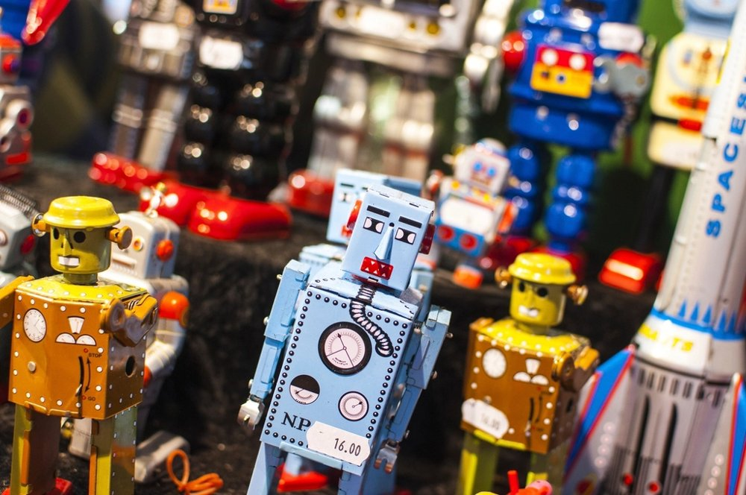
Common mistake: “Thanks, Copilot!”
STEP 05 · CONTINUE OR START FRESH?
Polite feels free. It isn’t: a bare “thanks” re-sends the whole chat, and the reply is billed too.
WHAT YOU TYPE VS WHAT IS SENT
WORKED EXAMPLE · CLAUDE SONNET 5.5
Thanks, that worked!
Warm cache, minutes later: 57,000 × $0.10 per 1M = 0.6 cr
Cold, after a break: 57,000 × $2 per 1M = 11.4 cr
5 tokens typed
You’re welcome! Glad it worked. Let me know if you need anything else.
10 cold thank-yous a day × 22 days
≈ 2,508 credits a month
17 output tokens, billed at the premium fare
More than a Business seat’s 1,900 monthly credits, spent on manners.
Starting context
12,000
15 earlier messages
45,000
“Thanks, that worked!”
5

Slide 26
The polite way that costs nothing
STEP 05 · CONTINUE OR START FRESH?
Keep the manners, lose the extra request.
FREE
BUNDLE IT
JUST STOP
FUN FACT
Click thumbs-up
Thank it in the next ask
Close or clear the chat
“Tens of millions”
The feedback buttons are not a model request, so they cost no tokens.
“Thanks, that worked. Now add a bloc_test case for a quantity of 0.” One request, not two.
Done? Walk away or /clear. Silence is the cheapest thank-you there is.
OpenAI’s CEO said in 2025 that people saying please and thank you costs the company tens of millions of dollars. He called it well spent.

Slide 27
Clear, compact, carry over
STEP 05 · CONTINUE OR START FRESH?
New topic: clear. Same task but a long chat: compact. Either way, keep the work, drop the history.
VS CODE
COPILOT CLI
VISUAL STUDIO
CLAUDE CODE
/clear or Ctrl+N
/clear · /compact
New thread
/clear · /compact
Or New Chat (+). ⌘N on macOS. /new scaffolds a project; it does not clear.
/compact swaps the chat so far for a summary, so later messages carry less.
Create new thread or Ctrl+N. /compact summarises instead.
/clear starts empty. /compact summarises and keeps going.
SUMMARISE FIRST
PLAN FILE
REFERENCE
ONE MODEL
10 bullets
#file:PLAN.md
Don’t paste
Per chat
“Summarise the decisions, changed files and open questions in 10 bullets.”
A few hundred tokens instead of the whole history.
Pasted logs ride along on every later message. #file sends only what’s needed.
Switching models halfway throws the cache away.

Slide 28
Calculation patterns
STEP 06 OF 09 · EXPERT
06
WHAT YOU WILL SEE
1
Agent loops add up
2
What the cache saves
3
Savings measured in the wild
The same price formula behaves very differently once an agent starts looping.

Slide 29
An agent loop, priced call by call
STEP 06 · CALCULATION PATTERNS
An agent makes 10 model calls. Each starts at 15K tokens and grows by 3K of tool output. Every call re-sends it all.
INPUT PER CALL · LIGHT = CACHED (80%) · DARK = FRESH
WORKED EXAMPLE · SONNET 5.5
Input: 285K tokens
Output: 10 × 500 = 5K
No cache: 57 + 5 = 62 cr
80% cached: 18.7 cr
11.4 fresh + 2.3 cached + 5 output. Same work, 70% less.
1
2
3
4
5
6
7
8
9
10

Slide 30
Measured: what trimming really saves
STEP 06 · CALCULATION PATTERNS
GitHub pruned unused tools, moved simple jobs to cheaper models, then measured.
AUTO-TRIAGE ISSUES
SMOKE CLAUDE WORKFLOW
SECURITY GUARD
−62%
−59%
−43%
Over 109 runs after the changes.
Partly from switching to a light model (Haiku).
Fewer tools, fewer tokens per call.
THE HIDDEN PASSENGER · TOOL DEFINITIONS
Enable only the toolsets the task needs.
A 40-tool MCP server adds 10–15 KB of tool schema to every turn. Pruning unused tools saved 8–12 KB per call.

Slide 31
Instructions, skills & hooks
STEP 07 OF 09 · EXPERT
07
WHAT YOU WILL SEE
1
Always on
2
Loaded on demand
3
Runs outside the model
Each piece enters the context at a different moment, so each costs differently.

Slide 32
When each one costs tokens
STEP 07 · INSTRUCTIONS, SKILLS & HOOKS
Some pieces ride on every request, some load only when needed, and hooks run outside the model.
Custom instructions
EVERY REQUEST
MCP tools
EVERY REQUEST
copilot-instructions.md · AGENTS.md
MCP server configuration
Path instructions
MATCHING FILES
Custom agents
WHILE SELECTED
*.instructions.md (applyTo)
.github/agents/
Prompt files
WHEN YOU RUN IT
Agent skills
WHEN RELEVANT
.github/prompts/*.prompt.md
.github/skills/<name>/
Hooks
OUTSIDE THE MODEL
.github/hooks/*.json

Slide 33
Your setup, priced per developer
STEP 07 · INSTRUCTIONS, SKILLS & HOOKS
Example sizes for one repository on Claude Sonnet 5.5, and a hook that trims what the model reads.
WORKED EXAMPLE · ALWAYS-ON COST
A POSTTOOLUSE HOOK TRIMS THE TEST LOG
Instructions 600 + skills list 300 + MCP tools 3,000
Agent runs the tests → test output
= 3,900 tokens on every request
× 200 requests a day = 780K tokens
9,000 tokens of log every pass and failure
= 156 credits a day × 22 working days
postToolUse hook keeps only failures
≈ 3,432 credits a month
With 80% from cache: about 824. A Business seat includes 1,900 a month.
400 tokens kept what the model reads
8,600 fewer tokens now, 51,600 in total once the next 5 calls re-send it.

Slide 34
How to write them
STEP 08 OF 09 · EXPERT
08
WHAT YOU WILL SEE
1
Which one do I need?
2
A one-screen map
3
Do’s and don’ts
Short and true beats long and complete. Templates, do’s and don’ts.

Slide 35
Which one do I need?
STEP 08 · HOW TO WRITE THEM
Pick the sentence that matches what you want. The examples come from an Orders API project.
INSTRUCTIONS
CUSTOM AGENT
SKILL
HOOK
“Every chat needs this.”
“I need a specialist.”
“A how-to, sometimes.”
“Run it automatically.”
Stack, build and test commands, folder map, rules the agent actually broke.
One job, a clear description, only the tools it needs, a model sized for the job.
Numbered steps and a clear finish line. Loads only when the task matches.
Block wasteful reads, trim noisy output. Runs outside the model.
One screen. ~600 tokens.
test-writer: read, search, edit, execute
unit-tests/SKILL.md
preToolUse · postToolUse

Slide 36
Short and true beats long and complete
STEP 08 · HOW TO WRITE THEM
An instructions file is paid on every single call. Here is what that means for 100 requests.
12×
cheaper, and the agent reads it faster.
WORKED EXAMPLE · 100 REQUESTS · $2 PER 1M
6,000-token manual
600K → 120 cr
500-token map
50K → 10 cr
DO
DON’T
✓ Keep it to one screen
✓ Write rules from real mistakes
✓ Give exact build and test commands
✓ Ask for diffs and short answers
✕ Paste architecture docs
✕ Copy advice that doesn’t match the code
✕ Add one-off preferences
✕ Put task recipes here (use skills)

Slide 37
Habits & final check
STEP 09 OF 09 · EXPERT
09
WHAT YOU WILL SEE
1
Habits that save tokens
2
Guess-the-answer quiz
3
Your cheat-sheet
Eight habits that cut tokens without cutting quality, then a quick quiz.

Slide 38
Habits that save tokens
STEP 09 · HABITS & FINAL CHECK
From GitHub’s own guidance on using AI credits efficiently.
01
02
03
04
Map, not manual
Detail goes in skills
New task, new chat
Plan to a file
Instructions ride on every request. Keep them short.
Skills and prompt files load only when needed.
/clear stops old history riding along.
Implement from PLAN.md in a fresh chat.
05
06
07
08
Cheap helpers
Unplug unused tools
Mind the cache clock
Reasoning is a dial
Sub-agents don’t inherit history: use a light model.
Every enabled tool is sent on every request.
Long break? Summarise, then start fresh.
Normal effort first, raise it for hard problems.

Slide 39
Quick quiz: shout the answer
STEP 09 · HABITS & FINAL CHECK
Each answer appears on the next click.
QUESTION 1
QUESTION 2
100 tokens is about how many English words?
Which is priced higher: input or output?
~75 words. 1 token ≈ ¾ of a word.
Output, about 5× on most models.
QUESTION 3
QUESTION 4
You switch model halfway through a chat. The cache…
12,000 in + 800 out at $2 / $10 per 1M is how many credits?
…is thrown away. Pick the model first.
2.4 + 0.8 = 3.2 credits.

Slide 40
Recap: nine steps on one page
MSDEVBUILD · CHEAT-SHEET
1
Start here
2
Learn tokens
3
Watch it generate
Input + cached + writes + output = credits. 1 credit = $0.01.
1 token ≈ 4 chars ≈ ¾ word. JSON ~2× English.
Output 3–8× input. Thinking tokens bill as output.
4
Best way to ask
5
Continue or fresh?
6
Calculation patterns
Task, context, constraints, done when. Ask for diffs.
New topic or long break: start fresh. Skip the bare “thanks”.
Agent calls re-send it all. Cache cuts ~70%.
7
Instructions & co.
8
How to write them
9
Habits
Always-on costs every call. Skills load on demand.
One-screen map. A 6,000-token file costs 12×.
One model per chat, unplug tools, reasoning is a dial.

Slide 41
Questions people usually ask
MSDEVBUILD · Q&A
Do all models split text the same way?
Why does output cost more than input?
No. Each model family has its own tokenizer, so counts differ a little. The 4-character rule is close enough to estimate.
Input is read in one pass. Each output token needs its own pass through the model, so it takes more compute.
Are code completions billed in AI Credits?
What is the fastest single saving?
Inline code completions are not billed in AI Credits on paid plans. Chat, agent and CLI requests are.
Start a new chat when the topic changes. History you no longer need stops riding along on every message.

Slide 42
Thank you
Questions?
MSDEVBUILD · Q&A
X
X
@jssuthahar
GH
GitHub
jssuthahar
Try one habit this week and watch your token count drop.
YT
YouTube
@MSDEVBUILD
Thanks for the thanks!
That’s 17 more tokens on the meter.
IG
Instagram
@msdevbuild

